Slide 1
Plainfield Work Orange Force Connector apple Routing Options

Slide 2
CIRTA has reviewed the current Plainfield Work Force Connector North and South routes. In efforts to improve efficiency and passenger needs we have established a few new options to consider for the upcoming service rebid.
CIRTA has added a 20 second stop time to each route bus stop. This allows for the driver to stay on time throughout the entire route improving schedule adherence and route reliability for the passengers.
As a new option, CIRTA has established a revised route plan that would tie in both routes into one. This allows for the complete round trip to be completed within 45 minutes and reduces one vehicle in service.
CIRTA would also change the route signage that would now include a bus stop number for each stop. Having the number will help passengers identify with specific drop off and pick up points along the route as currently some stops are between multiple facilities.
We are currently working on identifying needs for both a weekend service and a third shift option that would run from roughly 9PM to 1AM. This would address the second shift employees leaving and any third shift employees that would begin.
We believe running one unit on a single route loop offering three shifts and potential weekends would be the most cost effective, increase ridership and improve overall system efficiency in meeting passenger and employer needs
We would suggest that we bid this as multiple options as follows that would allow for flexibility and choices in service as associated costs.
Option one: one route system 5 days a week morning and afternoon.
Option two: two route system operating 5 days a week morning and afternoon.
Option three: night shift route for single route 5 days a week.
Option four: night shift route for two routes 5 days a week.
Option five: weekend service all three shifts single route
Option six: weekend service all three shifts two route system.
These options and associated costs would allow for CIRTA and the EID to pick the best variations in service types, days and hours in meeting passenger and employer needs in determining final award services for a new implementation within budget guidelines.

Slide 3
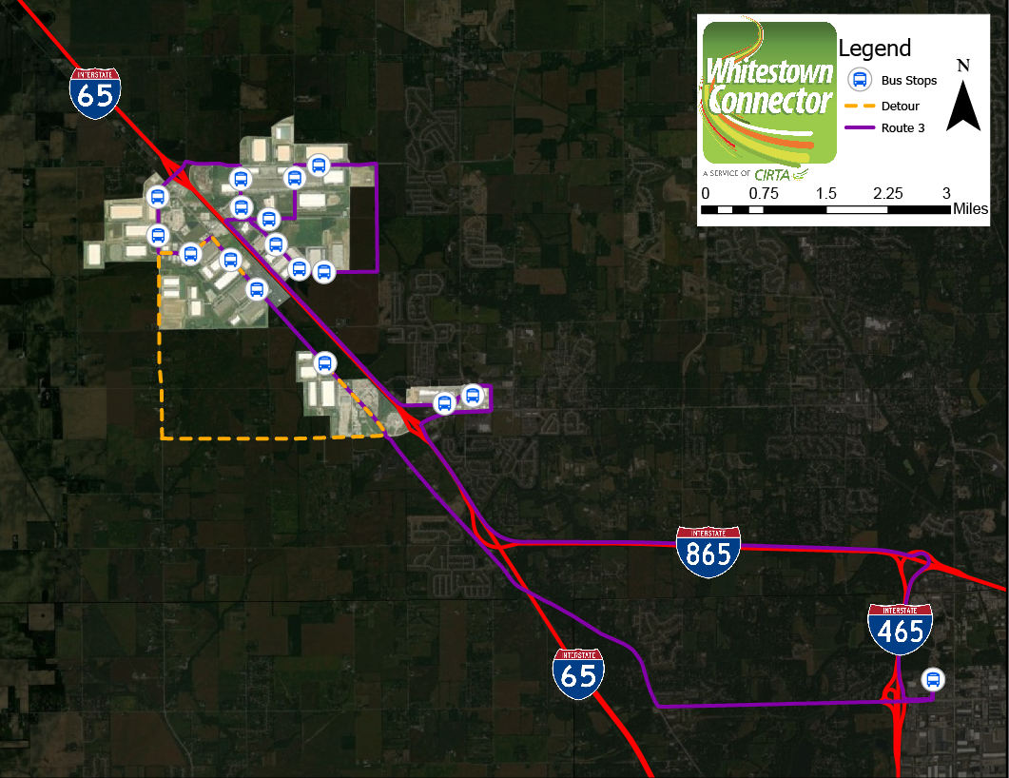
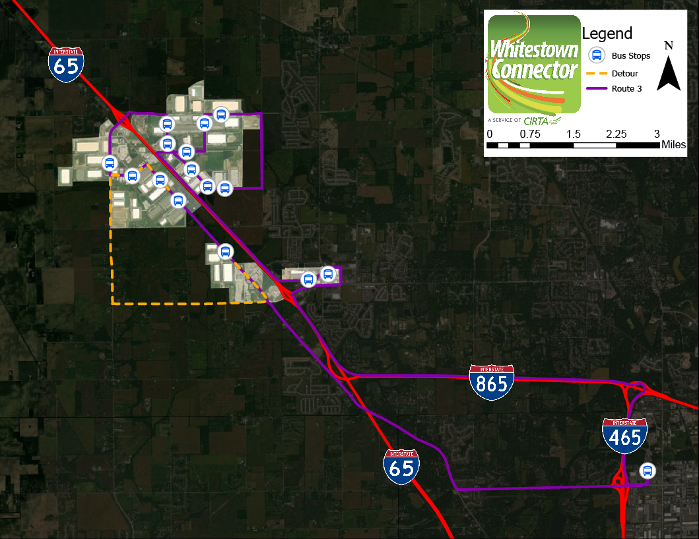
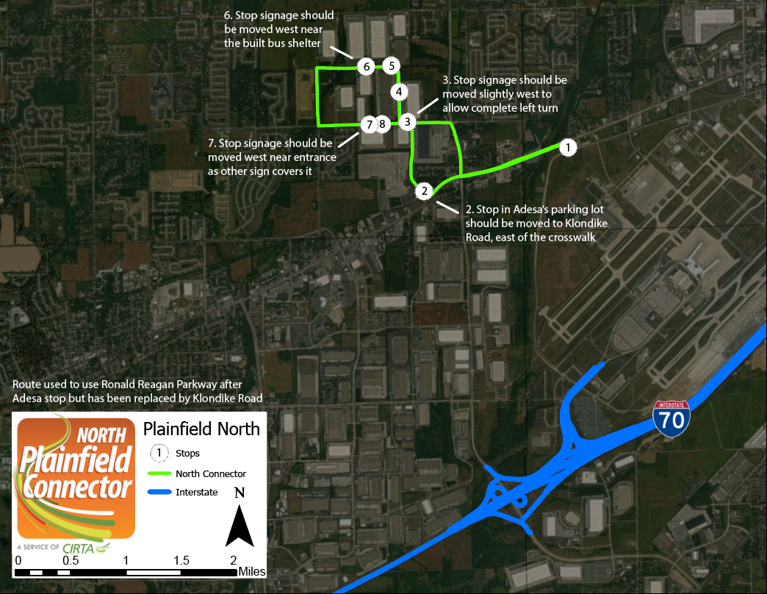
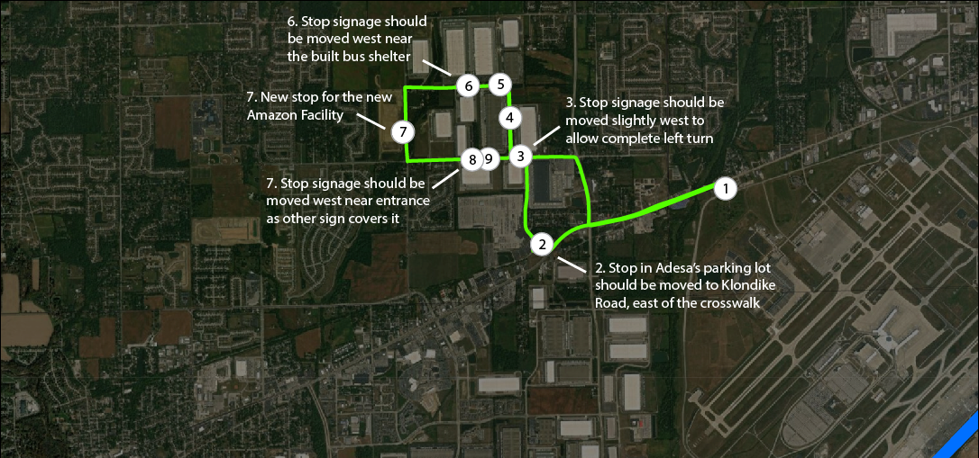
One-Route Proposal

Slide 4
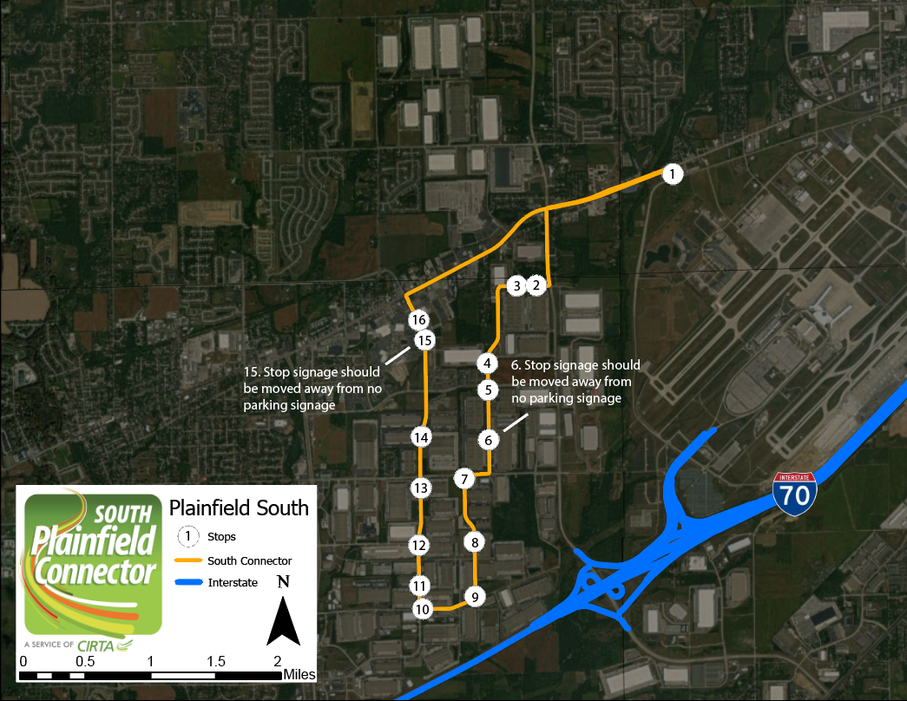
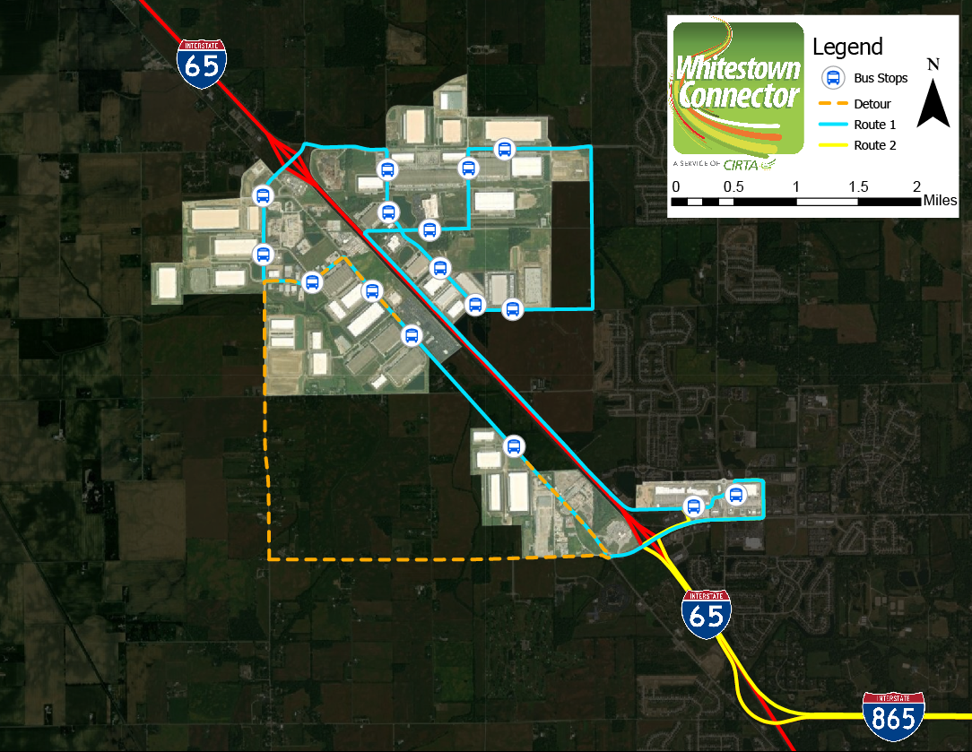
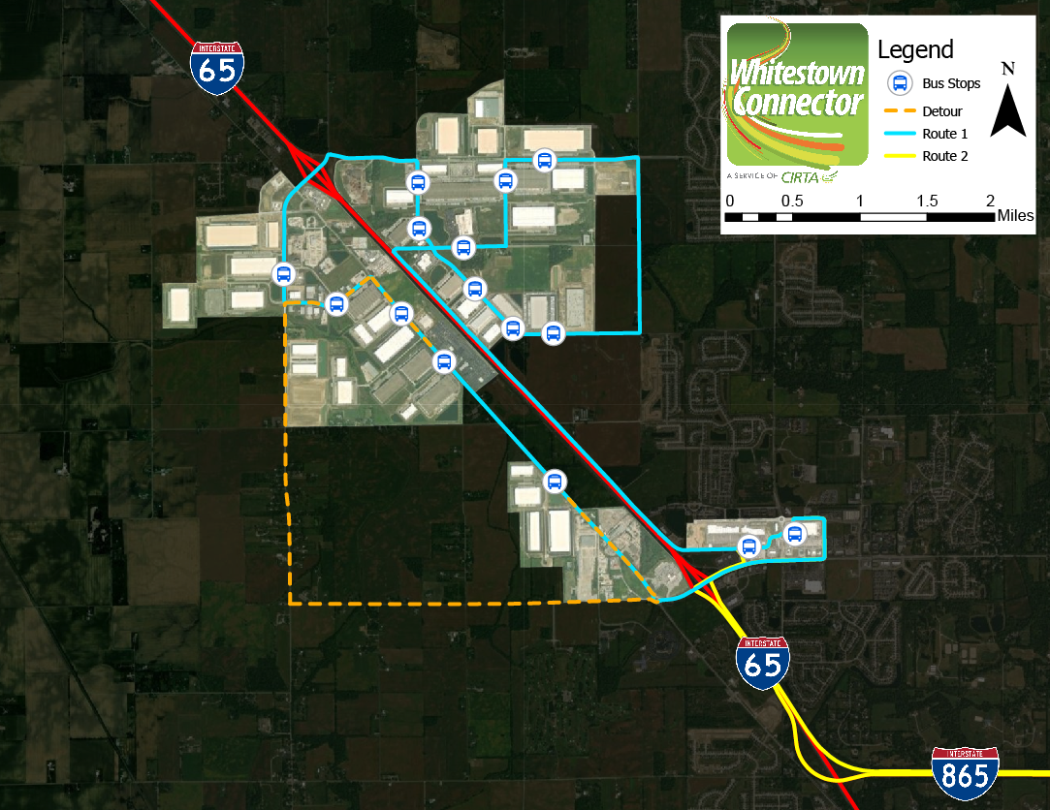
Whitestown Area

Slide 5
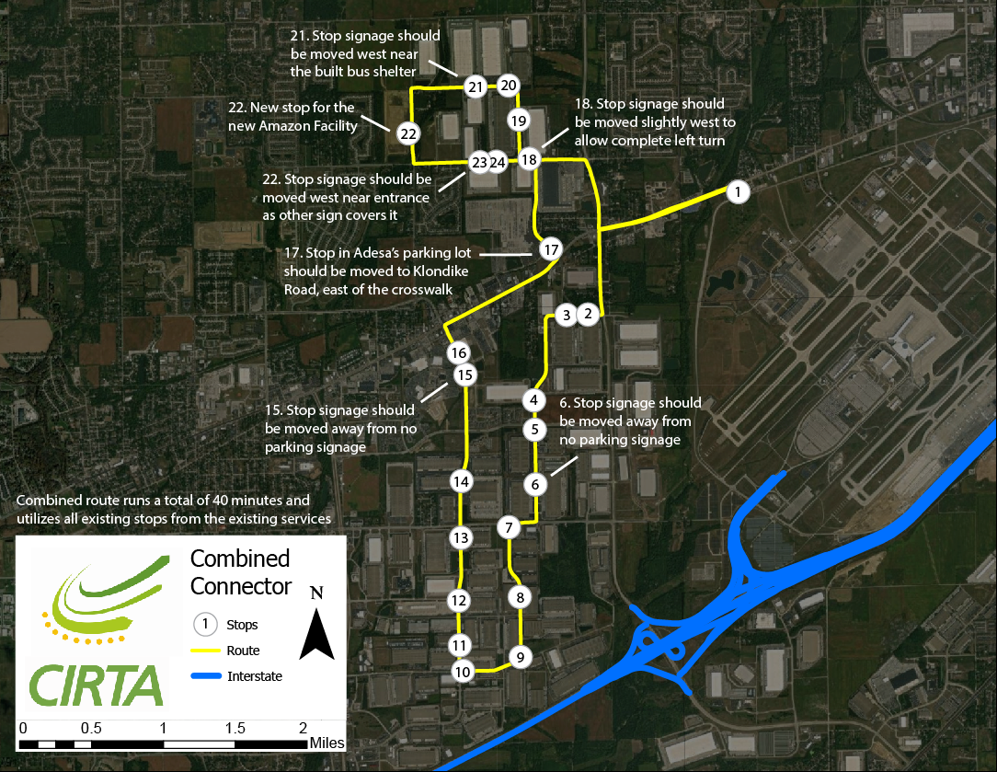
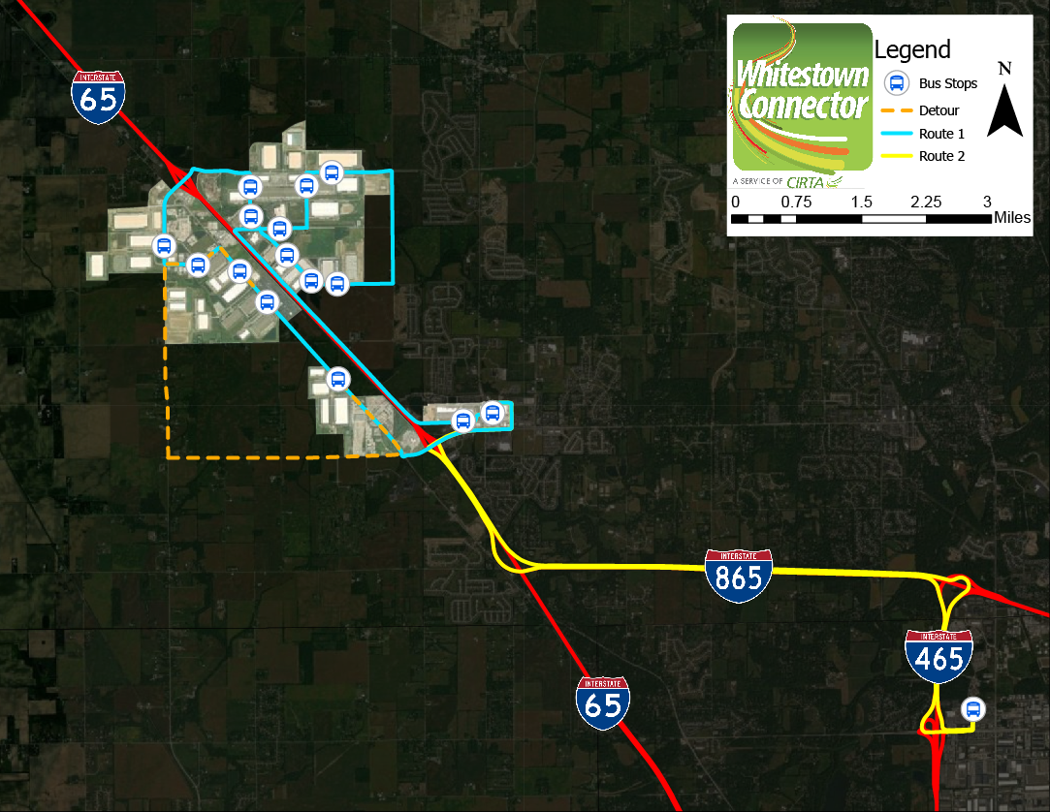
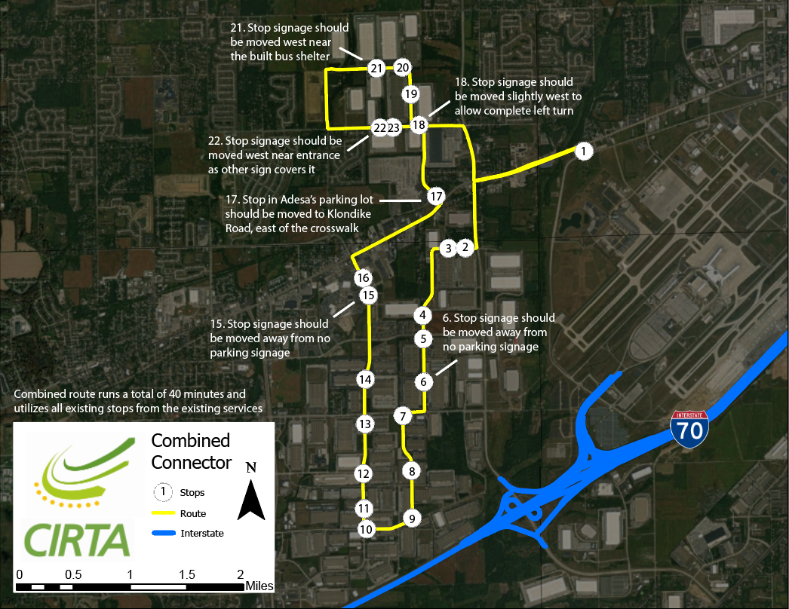
Two-Route Proposal

Slide 6
On behalf of Mohammad Khan and myself we appreciate your time and look forward to continuing our partnership with Plainfield and the EID in the work force connector services.
Let’s continue to work together in connecting people to places and opportunities.
Sincerely,
John Seber
Executive Director
Central Indiana Regional Transportation Authority
320 North Meridian Street Suite 920
Indianapolis, IN 46204

